Slide 1



DIGITAL VOTING SYSTEM
ARTIFICIAL INTELLIGENCE & MACHINE LEARNING

Slide 2
Presenting by:
Gagan D N(1CE21AI009)
Naman Bafna(1CE21AI011)
Abrar Ashraf(1CE21AI001)

Slide 3
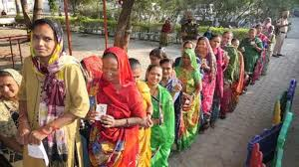
Problem
Voting difficulties faced my migrants
Apply for voter id and its issuance
Nomination filing
Voter data management
Complexity in Election organizing
Delayed in results and count
EVM cost and maintenance
Cost for organizing and maintenance

Slide 4
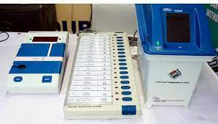
Survey information
Conduction of Election:
*Nearly cost:100-120Cr
*40%-EVM Machines(per unit-8600)
*other Expences
*Rate of voters-64%

Slide 5

Solution?
Digitalization of Voting System

Slide 6
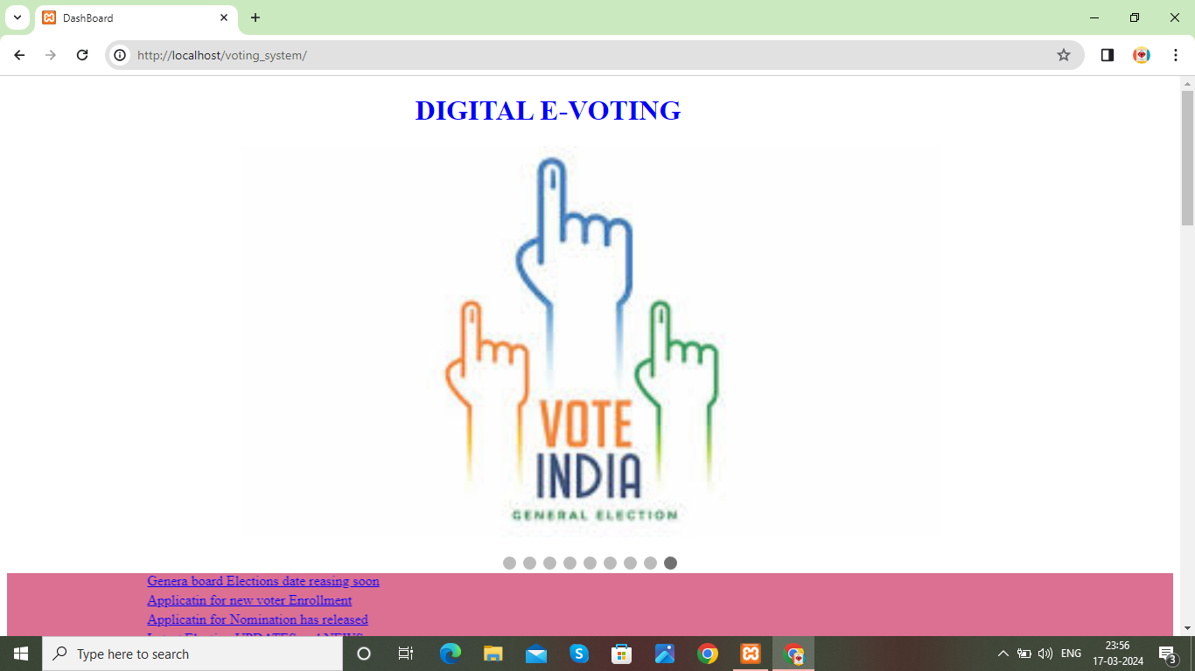
DIGITAL VOTING SYSTEM

Slide 7
Advantages of Digital voting System
To increase efficiency.
Voting from remote areas
To easy to use.
To cost effective.
User friendly.
Highly convenient From Traditional system.
Easy to maintain voters and nominees data.
Simple and easy to organize Elections
Instant Results

Slide 8
Use Case:
Server : Xampp
Languages :HTML , CSS, JS,PHP
Visual studio Code
Browser : Chrome
Windows10

Slide 9
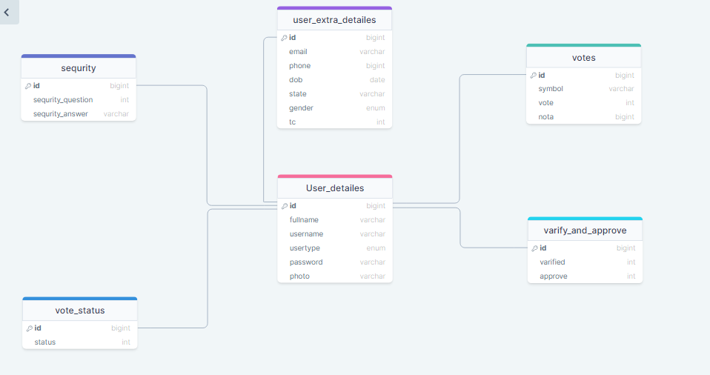
Schema diagram:

Slide 10
ER Diagram:

Slide 11
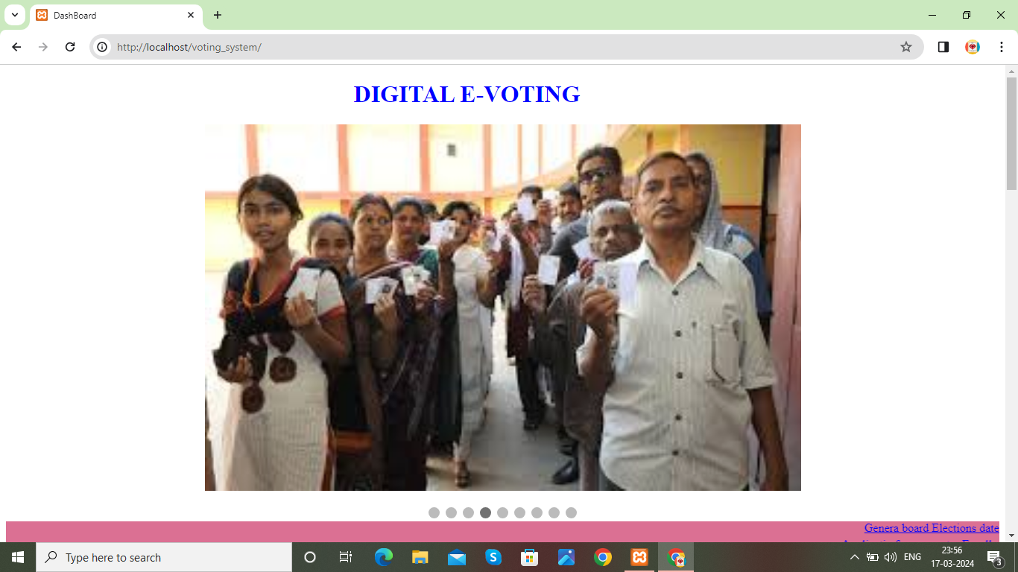
Demonstration

Slide 12

Login page

Slide 13
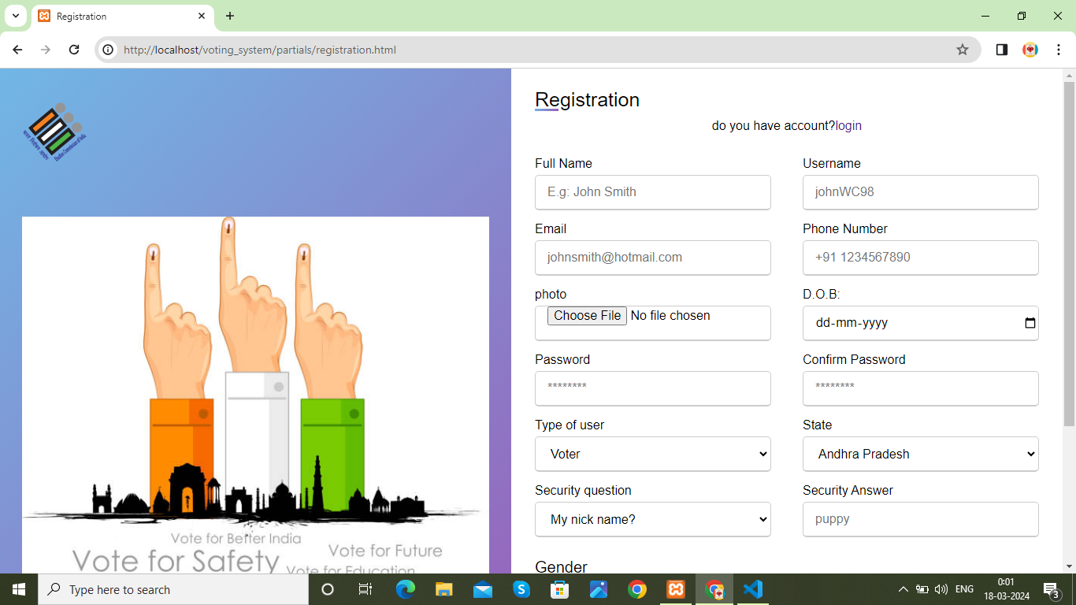
Registration page

Slide 14
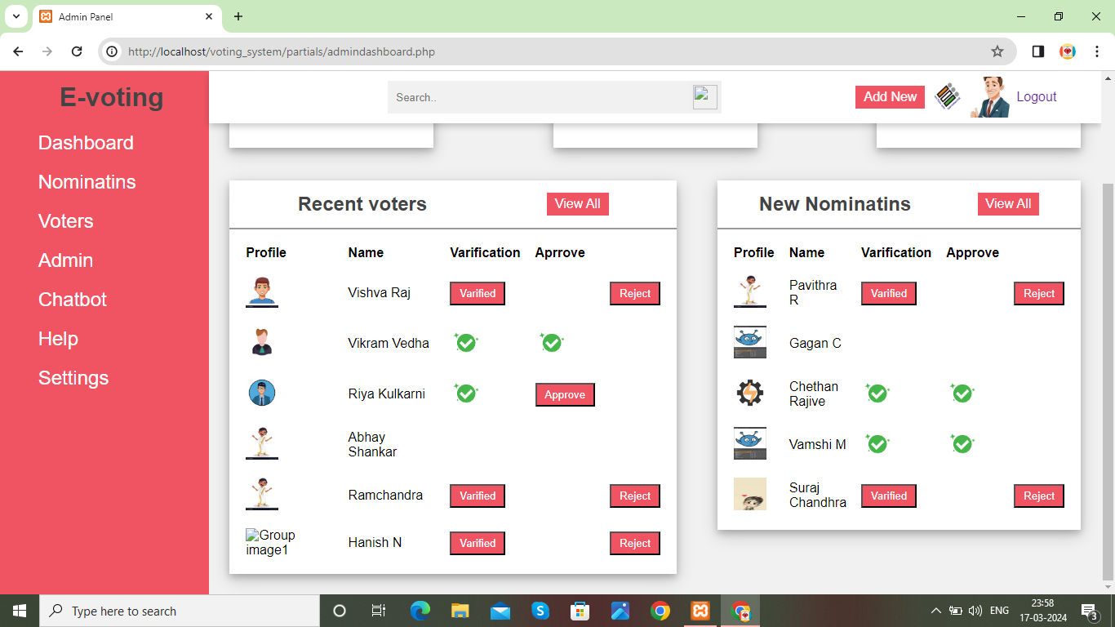
ADMIN DASHBOARD

Slide 15
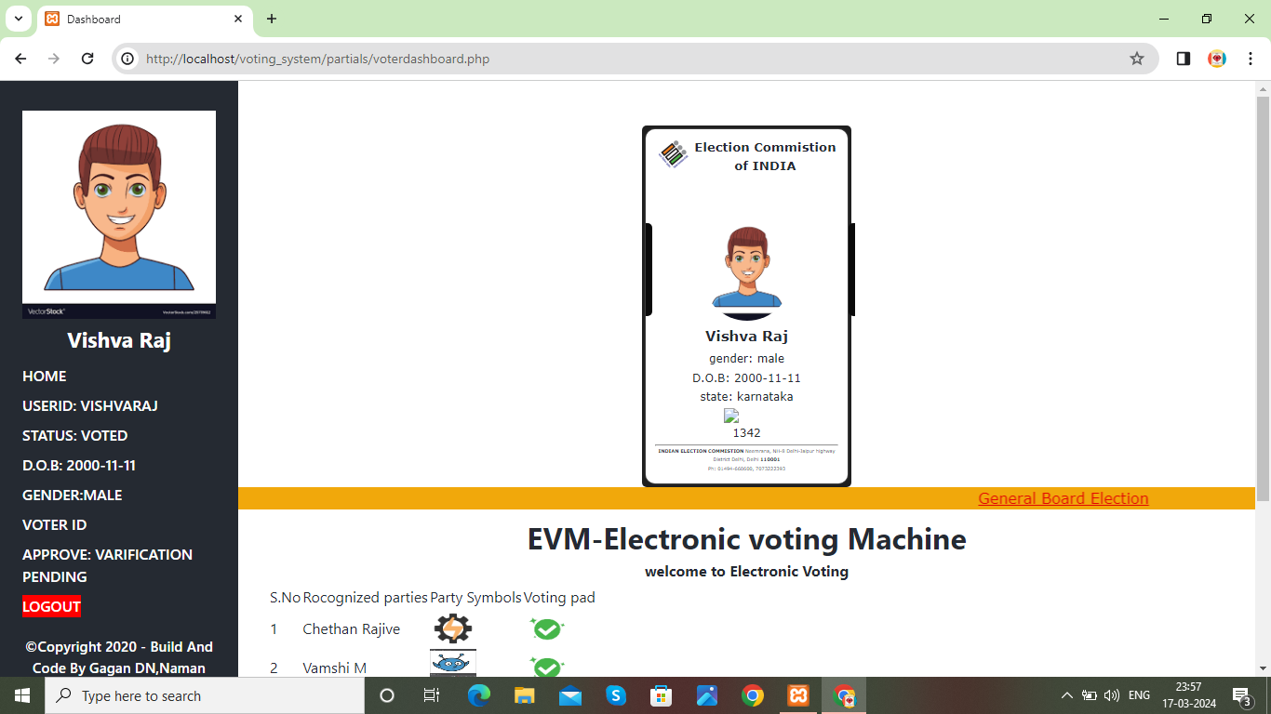
VOTER DASHBOARD

Slide 16
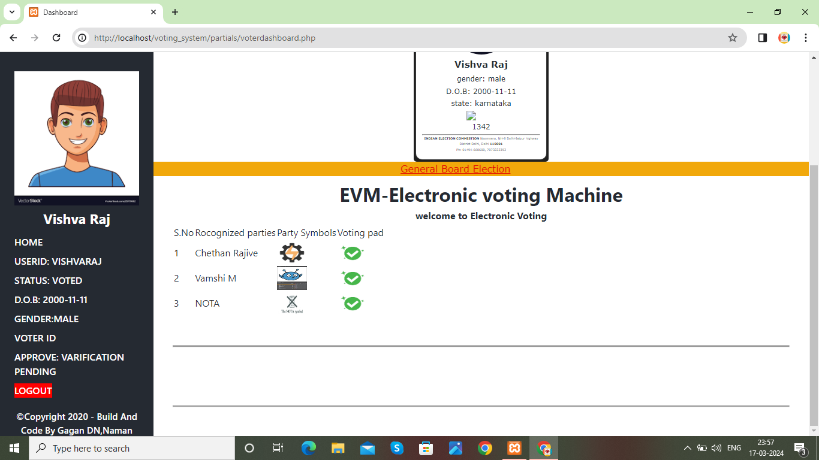
VOTER DASHBOARD EVM

Slide 17
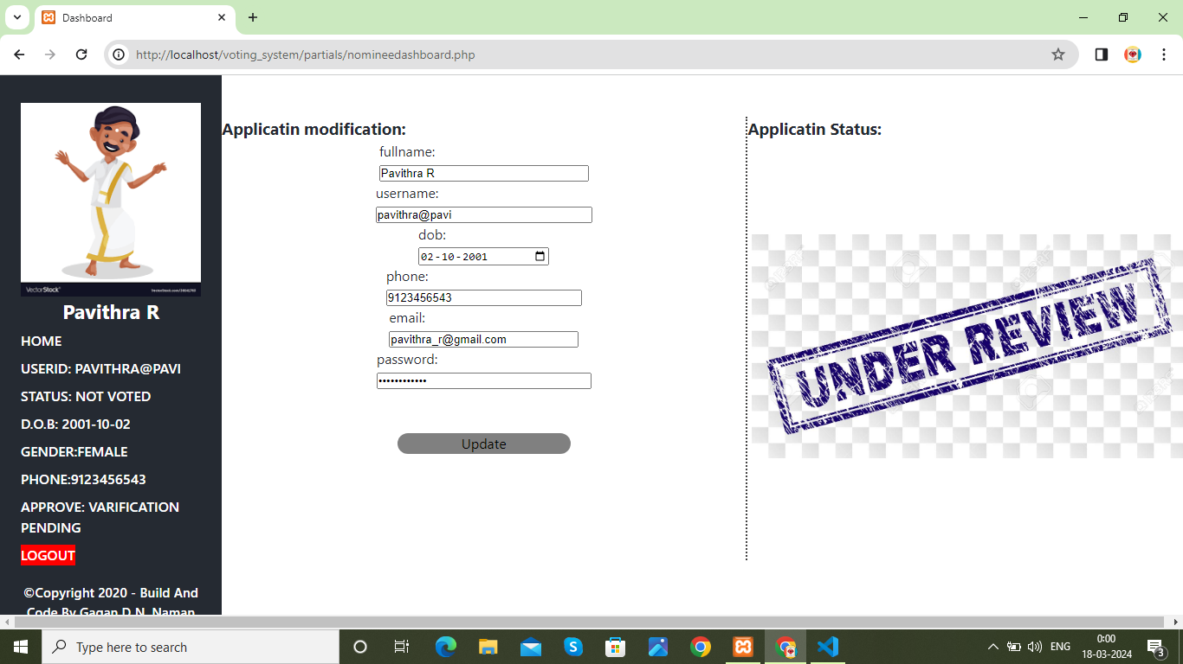
Nominee DashBoard

Slide 18




Thank you

